Slide 1
Aeroguard 4s
Next Generation Air Purifier

Slide 2
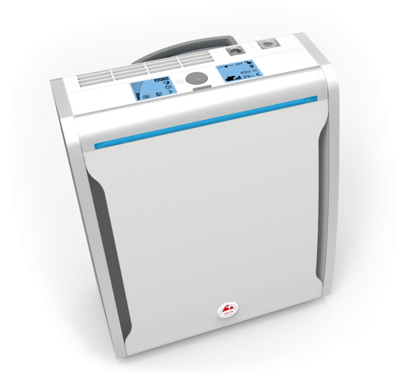

HIghlights
High quality Components
Double display with innovative control button
Visiolight -
Performance and service indication
9.2 kg – The lightest in its category
Optimised air flow
Convenient access to all modes and functions from a distance up to 6m
New air inlet
Compact and light

Slide 3
usability
Operating functions |  | Service functions
 | Automatic air control |  | Humidity in the room
 | Night mode |  | Desired humidity value
 | Power Mode (+ timer) |  | Air contamination
 | Manual mode (+ timer) |  | Room temperature
 | Noise mode |  | Change filters / UV lamp
 | Duotron on/off (ionisation)
 | Visiolight on/off
 | Display locking
 | Change display
 | Timer

Slide 4
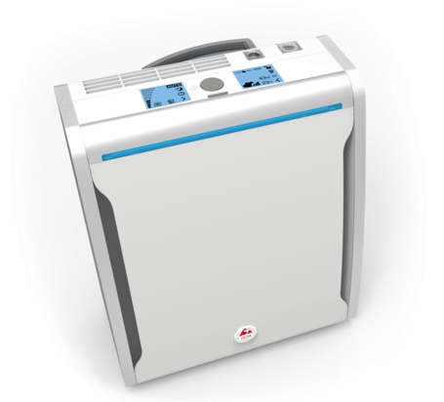
Visiolight – see your air quality
The Visiolight constantly shows the quality of the air in the room
^{Blue Very Good}
^{Light Purple Good}
^{Dark Purple Moderate}
^{Red Bad}
^{Red Change Filter}

Slide 5
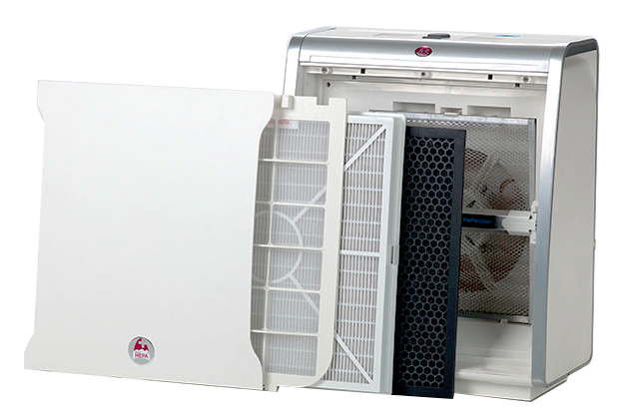
USability
The Visiolight indicates to the user when the filters should be changed
Automatic Safety Shutdown
  Filter exchange indication appears after 12 months
  After 14 months without filter exchange → Automatic shutdown
  100% clean air guarantee for customers
  Promoting after-sales
Easy Maintenance
  Magnetic adjustment of the front cover → Easy to open

Slide 6
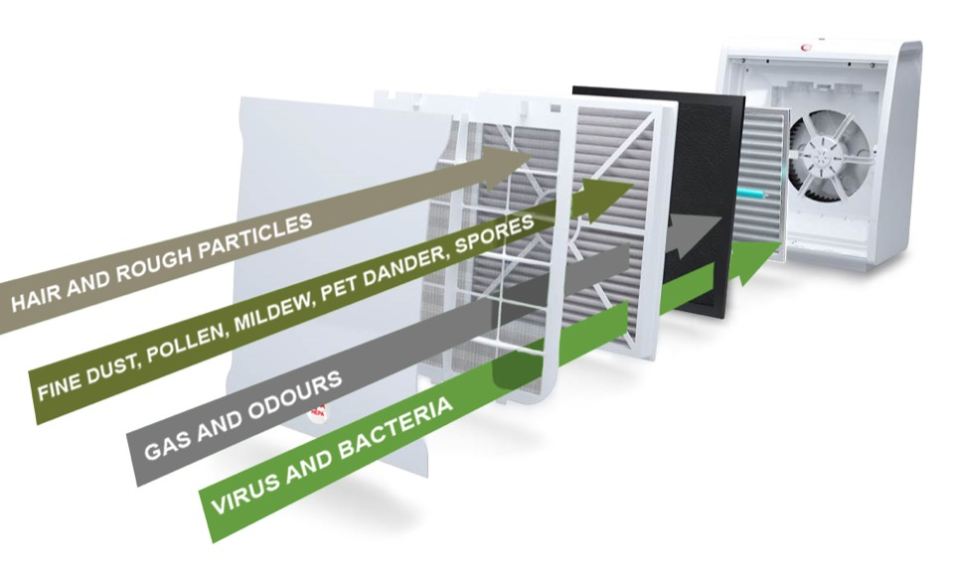
Filtration Technology – 5 Filters
NANOPURE+
Active carbon filter
SWISS HEPA H13
Pre-filter

Slide 7
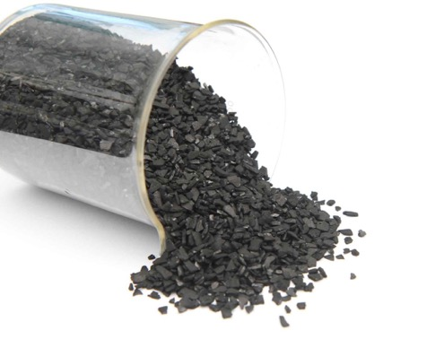
Filtration Technology
Prefilter
Proven Technology
User-friendly maintenance
Improved Active Carbon Filter
Less air resistance
Better performance

Slide 8

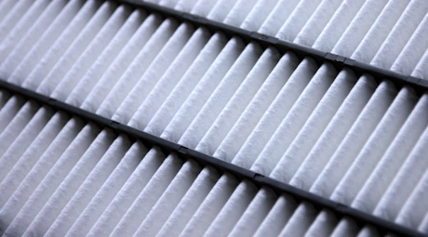

Technology
Filtration
SWISS HEPA TM
New world unique Swiss HEPATM filtration technology of Lux
Made in Switzerland
Patented woven fabric
Special treated fabric
HEPA H13 (99.95% mpps)
50% less air resistance
  less power consumption
  less noise

Slide 9

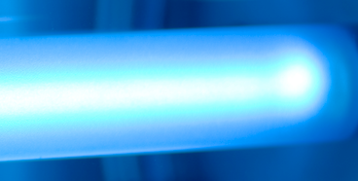
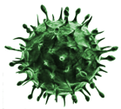

Antivirus technology
The ultraviolet light energy is 10,000 times more powerful than sunlight
Combined with the PCO system is able to damage the organic molecular bond.
Damages the micro- organism like germs, bacteria, viruses, fungi.

Slide 10
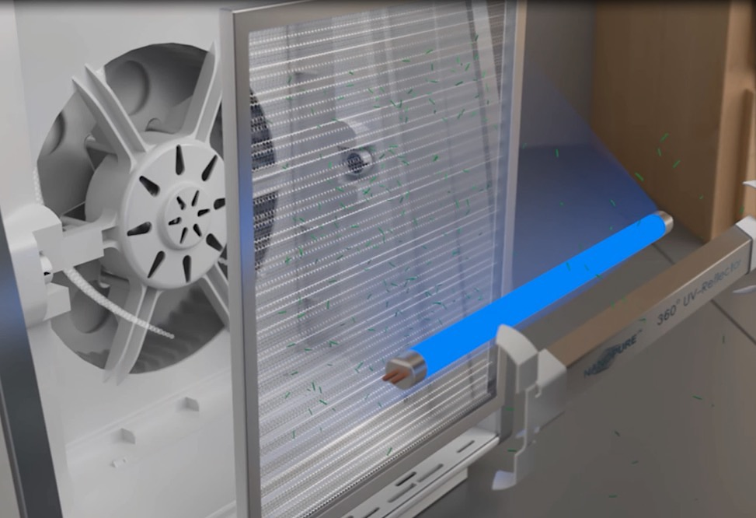

Photocatalytic oxidation
The rays from the UVA lamp activate the Titanium Dioxide applied on the aluminium grid
Virus and bacteria that are hit by this process are destroyed and made harmless
The reflector redirects the rays and reinforces the process.

Slide 11
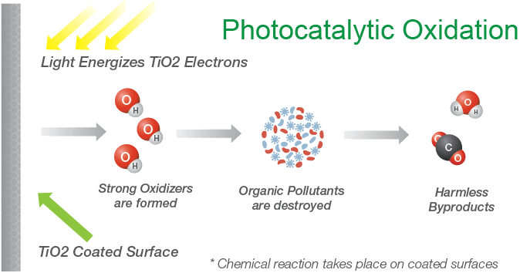
Photocatalytic oxidation
PCO Grid

Slide 12
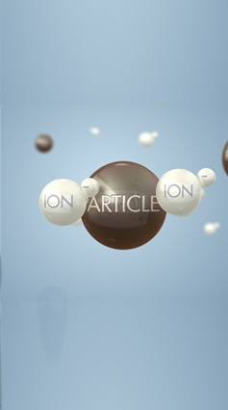

Technology
Filtration
Lux exclusive technology
Two sources of Ions combined
Removes viruses and bacteria from the air
Reduces bacteria growth on surfaces
High concentrated negative & positive ions
Highest cleaning efficiency
Swiss Air Treatment Technology

Slide 13
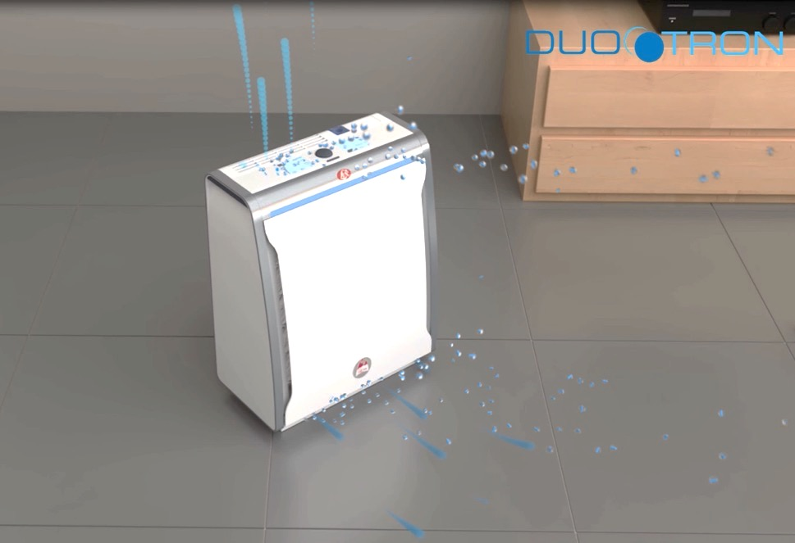
Negative ions bond with pollutants in the air and make them heavier. This make them fall to the floor
Negative ions are diffused in the air by the air outlet stream
-
Negative Ions give the indoor air an energetic and fresh touch
Positive Ions deposit on the HEPA and carbon filter reducing bacteria growth
+ Positive Ions are released in the front part of the unit
+
Through the charge of the positive ions, the cell walls of virus and bacteria are destroyed.
«Ionisation helps to retain bacteria growth»
Dr. A. Winkens (gui-lab)

Slide 14
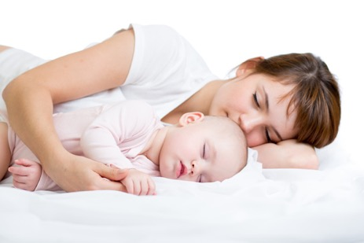
Health Benefits of Ionised Air
Stimulation of Nervous System
  Improving mental concentration
  Less tiredness
  Feeling of relaxation
Strengthening the Cardiovascular System
  Negative Ions support better blood flow in the body
  Stabilisation of pulse frequency
Improving Oxygen Intake
  Increase of endurance performance
  Feeling more vital
Reduction of bacteria growth
  Ions hinder the cell division of bacteria
  Prevention from air borne diseases
«Ions have a positive impact on human vital functions.»
Dr. A. Winkens (gui-lab)

Slide 15
Performance
Clean Air Delivery Rate & Room Size Capacity
30%
more compact
Slim line design
 |  | Aeroguard | Aeroguard 4S
 |  | m³/h | m³/h
1 | Silent | 25 | 18
2 |  | / | 45
3 | Standard | 40 | 200
4 |  | / | 260
5 | Medium | 130 | 330
6 |  | / | 390
7 | High | 220 | 450
8 |  | / | 500
9 | Turbo | 340 | 560
+
35%
lighter
From 12.5 kg to 9.2 kg
20%
improved cleaning performance
Final Lab-Figures will follow soon.

Slide 16
Aeroguard 4S vs Aeroguard
 | Aeroguard 4S | Aeroguard
Dimension (WxDxH) | 45 x 23 x 53 cm | 50 x 33 x 59 cm
Weight | 9.2 kg | 12.5 kg
Energy consumption w/o UV (min-max) | 17 / 73W | 24 / 150W
Air flow | 560 (m3/h) | 220 (m3/h
Filtration mmps | 99.97% | 99.97%
Speed levels | 9 | 5
Air quality indication | Display + Visiolight | Display
Locking function | Yes | No
Humidity and temperature indication | Yes | No
Timer-Function | Yes | No
Humidifier | Yes | No
Noise level (speed level 1) | 33 dB | 36 dB

Slide 17
10 reasons why the aeroguard 4s is the next generation of air purifier
01
Highest cleaning performance ever
06
DUOTRON Technology
02
Light & compact
07
New modern Swiss Design
03
Synthetic SWISS HEPATM Filter
08
Userfriendly Single Button control
04
4 in1 (Cleaner + Ionizer + Aromizer + Humidifier)
09
Optional Remote Control
05
Performance & Service light-bar
10
Optional Humidifier

Slide 18
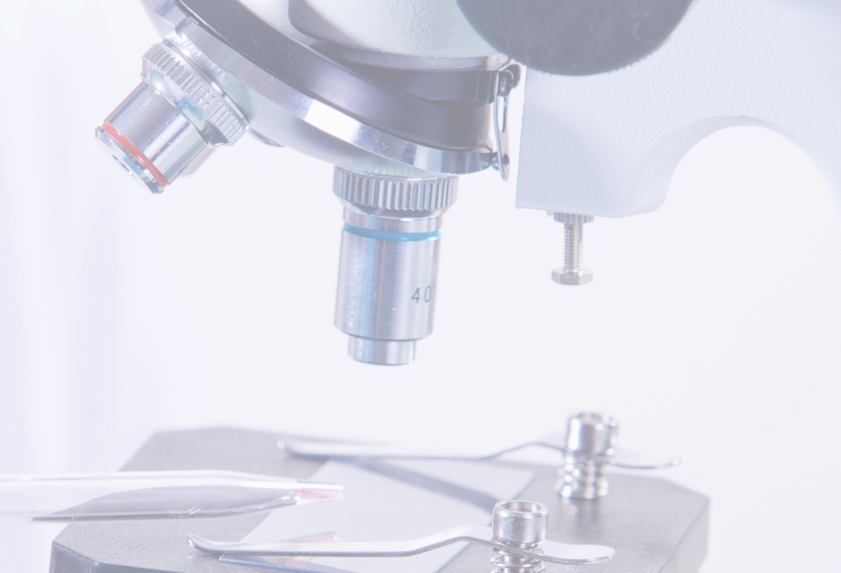
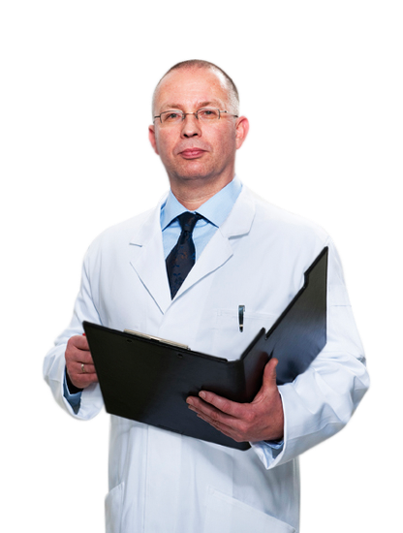



Technology
Recommended by experts
aha!
Swiss Allergy Center
gui lab
Association of environmental engineers and laboratories
TÜV NORD
Systems GmbH & Co. KG

Slide 19
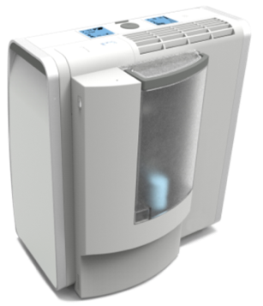
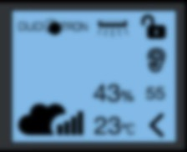

Optional humidifier
Compact, light and elegantly integrated in the Aeroguard 4S purifying system
2.6 Litre removable tank with handle
Descaling cartridge
Low energy consumption
The Aeroguard air flows supports the wide distribution of humidity in the room
The hygrometer integrated in the Aeroguard 4S constantly measures the relative humidity indoors (%)
The desired humidity can be set on the display

Slide 20
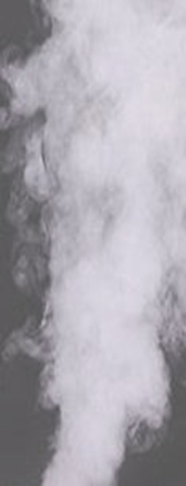
Hygienic technology
The Aeroguard 4S humidifier has been developed using the latest Ultrasonic Nebulizer Technology
  Cold atomisation
  Unique design to avoid humidity condensation on furniture
  Very low energy consumption
  Silent technology
«Ultrasonic nebulization is the most hygenic technology for air humidification.»
Dr. A. Winkens (gui-lab)

Slide 21
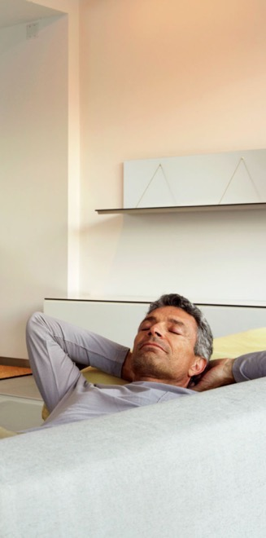
Health Benefits
Recommended air humidity for indoor spaces is 45% - 55%.
Indoor Air Humidity should not be below 30%
Protection from airborne viruses
  High air humidity lowers infection risk of viruses
  A humidity of 40% drops infection risk drastically
Prevention from health risk caused by dry air
  Skin irritations, Inflammations, Dry eyes

